Slide 1

Data Structures: Graphs
Dr. Murali Krishna Enduri
Department of CSE

Slide 2
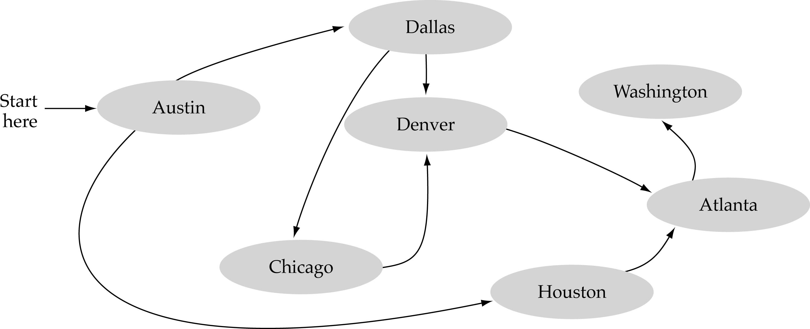
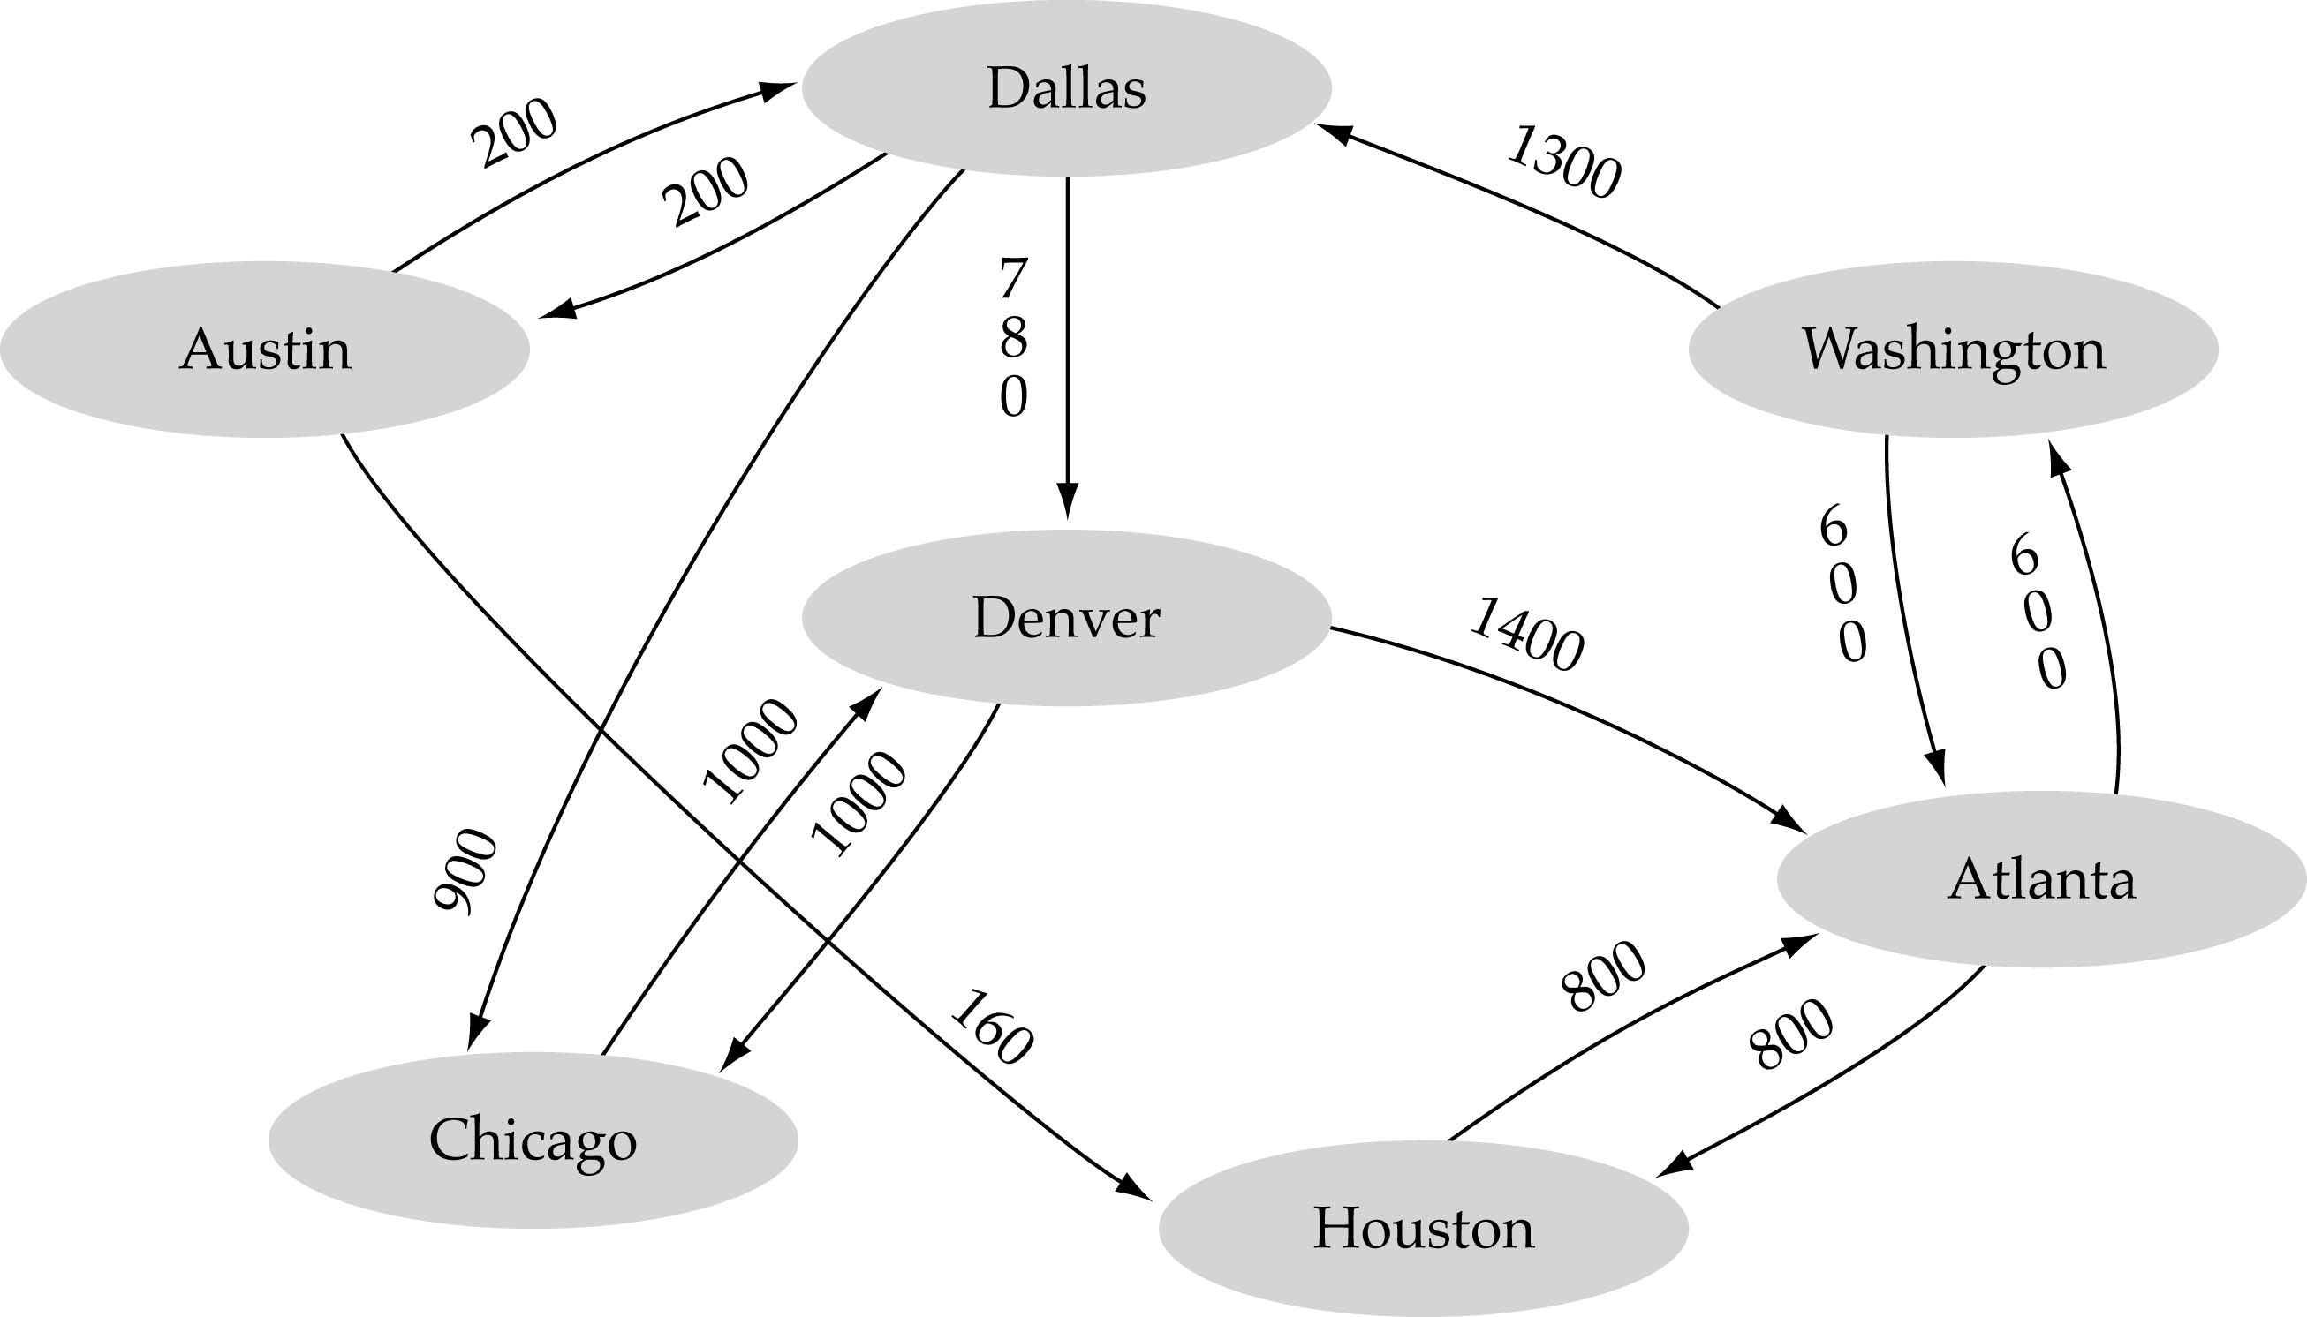
What is a graph?
A graph is a non-linear data structure
A data structure that consists of a set of nodes (vertices) and a set of edges that relate the nodes to each other
The set of edges describes relationships among the vertices

Slide 3
Graphs are Everywhere
- Roadmaps: The networks may include paths in a city
- Communication networks : Routers in wired and wireless networks
- WWW: Graphs are also used in social networks like linkedIn, facebook.
- Electrical circuits: The networks may include paths in a telephone network or circuit network.
- Task schedules: We come across the Resource Allocation Graph where each process and resources are considered to be vertices in operating system

Slide 4
Graphs Terminology
Directed
connected
0
0
0
1
2
1
2
1
3
3
4
5
6
2
G1
G2
G3
tree (acyclic graph)
Connected graph: There is a path between each two vertices
Disconnected graph : There are at least two vertices not connected by a path.

Slide 5
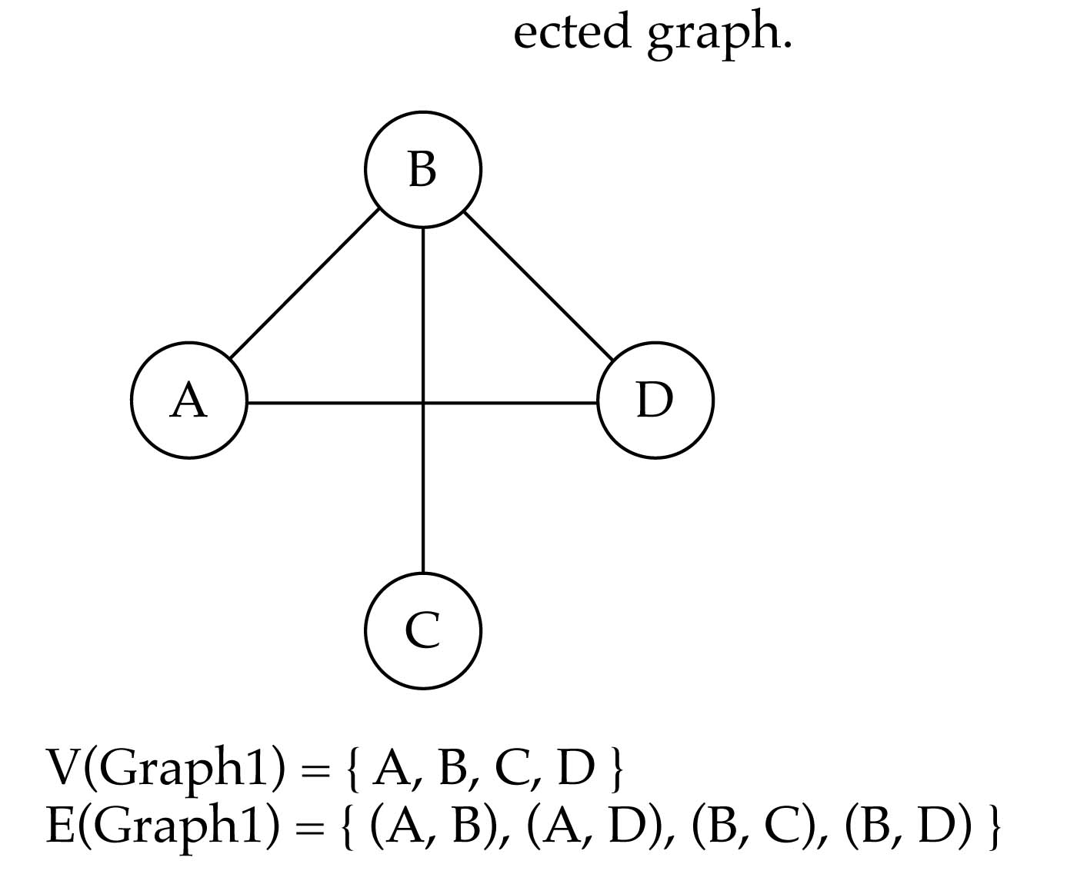
Graphs Basics
A graph G is defined as follows:
G=(V,E)
V(G): a finite, nonempty set of vertices
E(G): a set of edges (pairs of vertices)
conn
Adjacent vertices: there is an edge between two vertices

Slide 6
Adjacency Matrix (2D array)
Let G=(V,E) be a graph with n vertices.
The adjacency matrix of G is a two-dimensional n by n array, say A
If the edge (vi, vj) is in E(G), A[i][j]=1
If there is no such edge in E(G), A[i][j]=0
The adjacency matrix for an undirected graph is symmetric; the adjacency matrix for a digraph need not be symmetric

Slide 7
Examples for Adjacency Matrix
G1
0
0
0
4
2
1
5
1
2
1
3
6
3
2
7
G2
G3
symmetric
undirected: n²/2
directed: n²

Slide 8
0
G1
0
4
1
2
2
1
5
3
3
6
0
1
2
3
1
2
3
7
0
1
2
3
4
5
6
7
1
2
0
2
3
0
3
5
0
1
3
0
3
0
1
2
1
2
0
5
0
1
2
1
1
4
6
0
2
1
5
7
6
G2
2
G3
An undirected graph with n vertices and e edges ==> n head nodes and 2e list nodes

Slide 9
Data Structures for Adjacency Lists (Linked list)
#define MAX_VERTICES 50
struct node {
int vertex;
struct node *link;
};
Struct node graph[MAX_VERTICES];
int n=0; /* vertices currently in use */
0
1
2
3
4
5
6
7
1
2
0
3
5
0
3
1
2
5
1
4
6
5
7
6

Slide 10
Adjacency matrix vs. adjacency list representation
Adjacency matrix
Good for dense graphs --|E|~O(|V|²)
Memory requirements: O(|V| + |E| ) = O(|V|² )
Connectivity between two vertices can be tested quickly
Adjacency list
Good for sparse graphs -- |E|~O(|V|)
Memory requirements: O(|V| + |E|)=O(|V|)
Vertices adjacent to another vertex can be found quickly

Slide 11
Some Operations on Graphs
Traversal Given G=(V,E) and vertex v, find all w in V, such that w connects v.
Depth First Search (DFS) preorder tree traversal in trees
Breadth First Search (BFS) level order tree traversal in trees

Slide 12
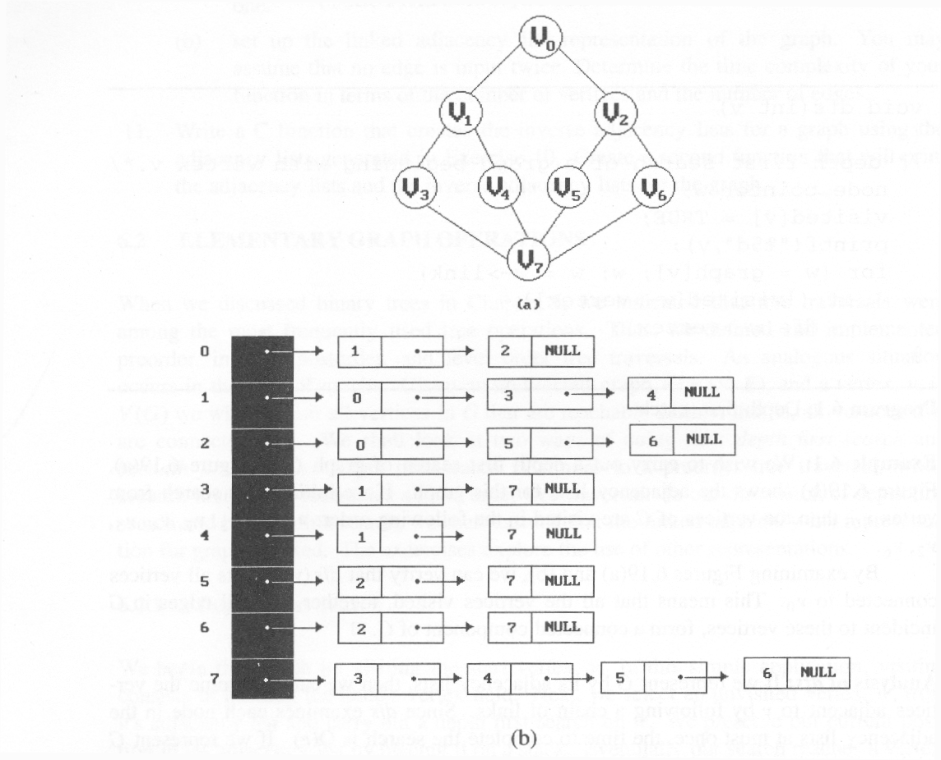
Depth-First-Search (DFS)
What is the idea behind DFS?
Travel as far as you can down a path
Back up as little as possible when you reach a "dead end" (i.e., next vertex has been "marked" or there is no next vertex)
DFS can be implemented efficiently using a stack
depth first search: v0, v1, v3, v7, v4, v5, v2, v6

Slide 13
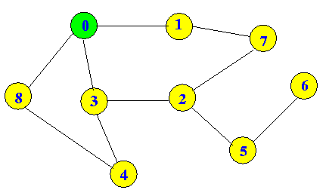
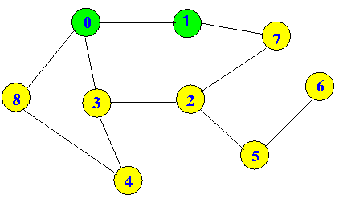
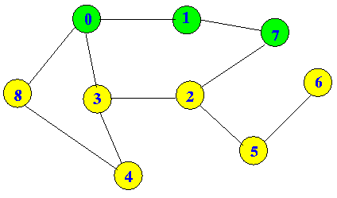
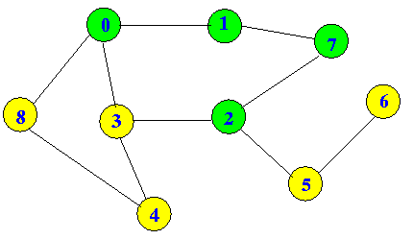
Depth-First-Search (DFS)
So…on
0, 1, 7, 2, 3, 4, 8, 5, 6

Slide 14
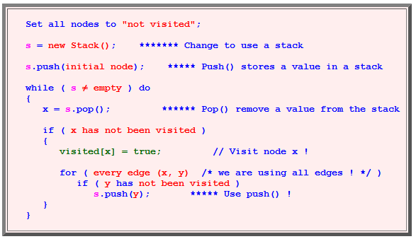
Depth-First-Search (DFS) Algorithm

Slide 15
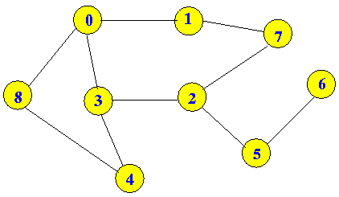
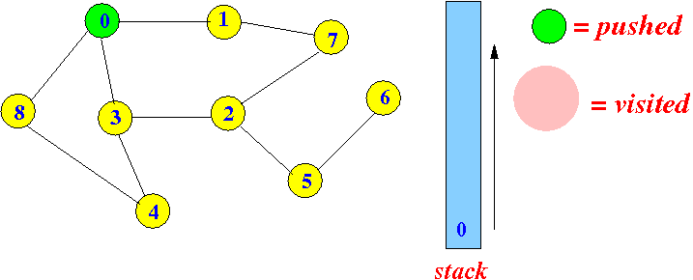
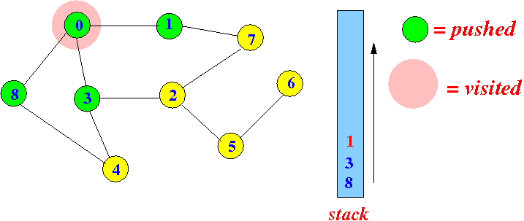
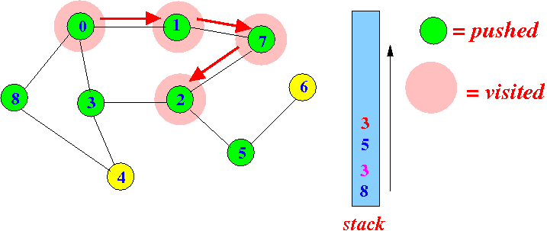
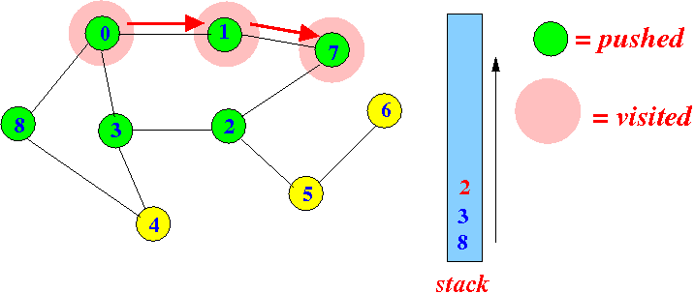
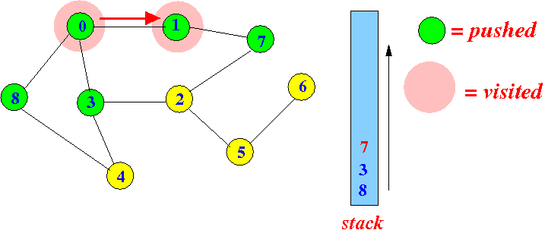
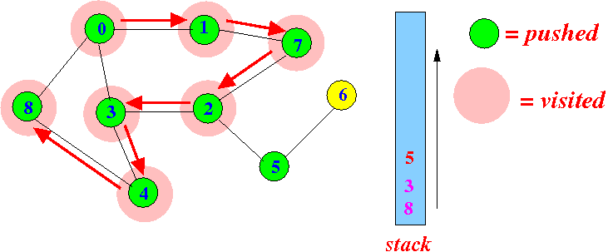
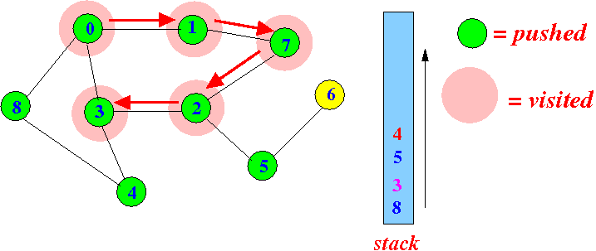
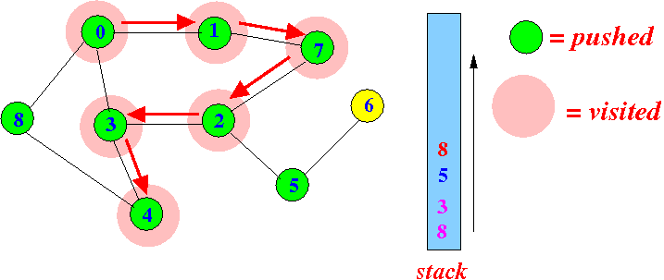
Depth-First-Search (DFS) Example

Slide 16
Applications Depth-First-Search (DFS)
For an unweighted graph, DFS traversal of the graph produces the minimum spanning tree and all pair shortest path tree.
Detecting cycle in a graph A graph has cycle if and only if we see a back edge during DFS. So we can run DFS for the graph and check for back edges.
Path Finding We can specialize the DFS algorithm to find a path between two given vertices u and z. i) Call DFS(G, u) with u as the start vertex. ii) Use a stack S to keep track of the path between the start vertex and the current vertex. iii) As soon as destination vertex z is encountered, return the path as the contents of the stack
Solving puzzles with only one solution, such as mazes. (DFS can be adapted to find all solutions to a maze by only including nodes on the current path in the visited set.)
To test if a graph is bipartite We can augment either BFS or DFS when we first discover a new vertex, color it opposited its parents, and for each other edge, check it doesn’t link two vertices of the same color. The first vertex in any connected component can be red or black!

Slide 17
Breadth-First-Searching (BFS)
What is the idea behind BFS?
Look at all possible paths at the same depth before you go at a deeper level
Back up as far as possible when you reach a "dead end" (i.e., next vertex has been "marked" or there is no next vertex)
DFS can be implemented efficiently using a Queue
0, 1, 3, 8, 7, 2, 4, 5, 6

Slide 18
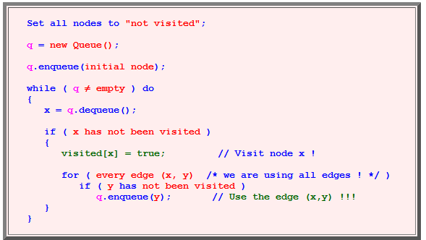
Breadth-First-Searching (BFS) Algorithm

Slide 19
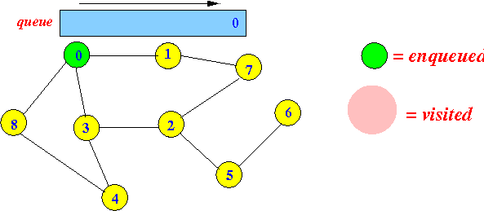
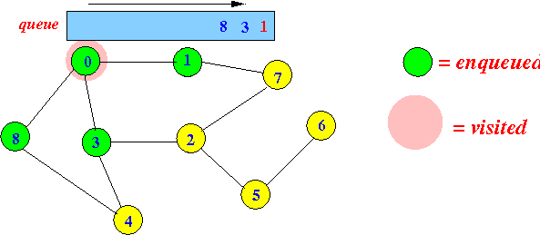
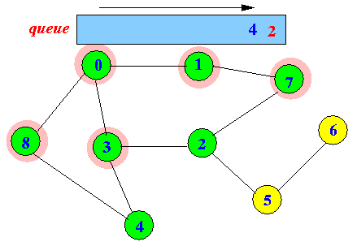
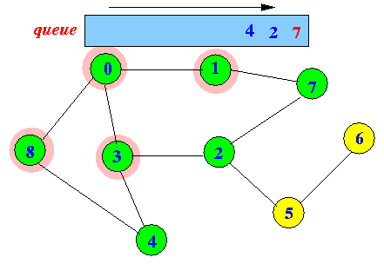
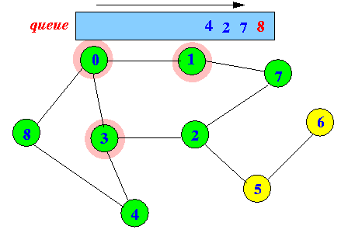
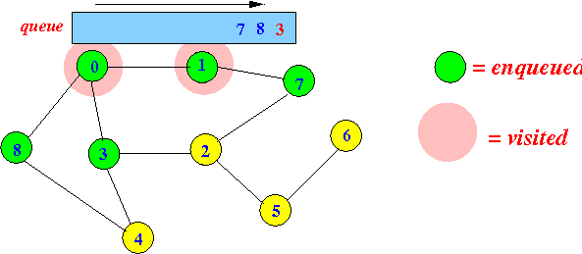
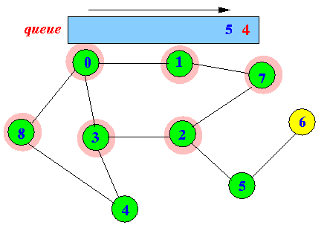
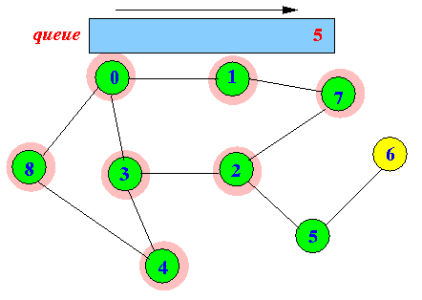
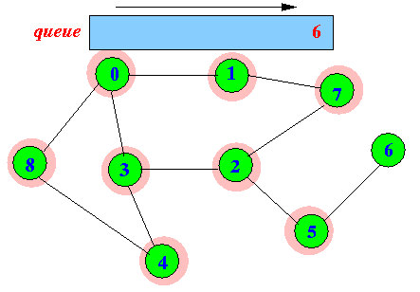
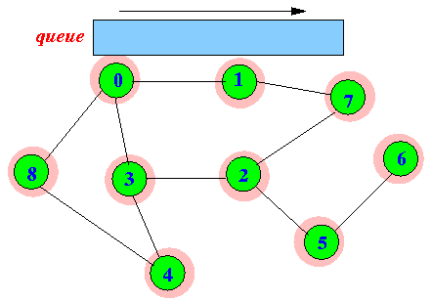
Breadth-First-Searching (BFS) Example

Slide 20
C code for Depth-First-Search (DFS) Using arrays
#include<stdio.h>
int G[10][10],visited[10],n;
void DFS(int i)
{
int j;
printf("\n%d",i);
visited[i]=1;
for(j=0;j<n;j++)
if(!visited[j]&&G[i][j]==1)
DFS(j);
}
void main()
{
int i,j;
printf("Enter number of vertices:");
scanf("%d",&n);
printf("\nEnter adjacency matrix of the graph:");
for(i=0;i<n;i++)
for(j=0;j<n;j++)
scanf("%d",&G[i][j]);
for(i=0;i<n;i++)
visited[i]=0;
DFS(0);
}

Slide 21
C code for Breadth-First-Search (BFS) Using arrays
void main() {
int v;
printf("\n Enter the number of vertices:");
scanf("%d",&n);
for (i=1;i<=n;i++) {
q[i]=0;
visited[i]=0;
}
printf("\n Enter graph data in matrix form:\n");
for (i=1;i<=n;i++)
for (j=1;j<=n;j++)
scanf("%d",&a[i][j]);
printf("\n Enter the starting vertex:");
scanf("%d",&v);
bfs(v);
printf("\n The node which are reachable are:\n");
for (i=1;i<=n;i++)
if(visited[i])
printf("%d\t",i);
else
printf("\n Bfs is not possible");
}
#include<stdio.h>
int a[20][20],q[20],visited[20],n,i,j,f=0,r=-1;
void bfs(int v) {
for (i=1;i<=n;i++)
if(a[v][i] && !visited[i])
q[++r]=i;
if(f<=r) {
visited[q[f]]=1;
bfs(q[f++]);
}
}

Slide 22
Applications of Graphs
Searching for a path from one vertex to another:
Sometimes, we just want any path (or want to know there is a path).
Sometimes, we want to minimize path length (# of edges).
Sometimes, we want to minimize path cost (sum of edge weights).
What is the shortest path from 0 to 5 ? Which path has the minimum cost?
$50
5
$70
3
1
$200
$130
$170
$80
5
$60
$140
0
$250
2
$120
$100
4
$110
6
$500

Slide 23
Applications of Graphs
In Computer science graphs are used to represent the flow of computation.
Google maps uses graphs for building transportation systems, where intersection of two(or more) roads are considered to be a vertex and the road connecting two vertices is considered to be an edge, thus their navigation system is based on the algorithm to calculate the shortest path between two vertices.
In Facebook, users are considered to be the vertices and if they are friends then there is an edge running between them. Facebook’s Friend suggestion algorithm uses graph theory.
In Operating System, we come across the Resource Allocation Graph where each process and resources are considered to be vertices. Edges are drawn from resources to the allocated process, or from requesting process to the requested resource. If this leads to any formation of a cycle then a deadlock will occur.

Slide 24
Graph Traversal Exercises
Breadth-First and Depth-First Traversal starting from ‘a’
Breadth-first
a f h e g i d j k c l n b m o
Depth-first
a f e d c b g h i j k l m n o

